Slide 1
River Ob
Teacher: Galina Victorovna
Student:Kozlovskaya Maria
Class: 8 “A”

Slide 2

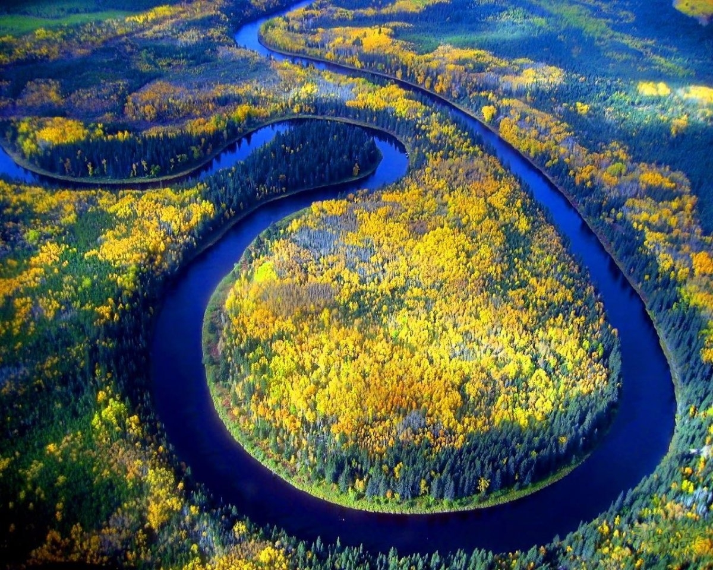
The Ob is one of the greatest rivers in the world.

Slide 3
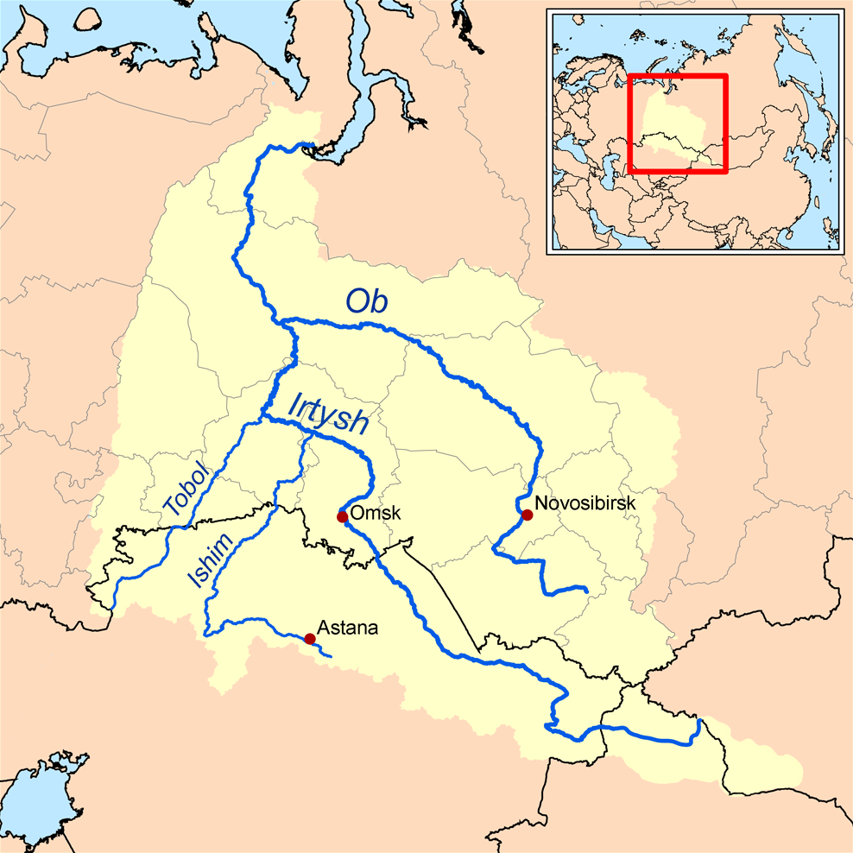
This river flows through Western Siberia.

Slide 4
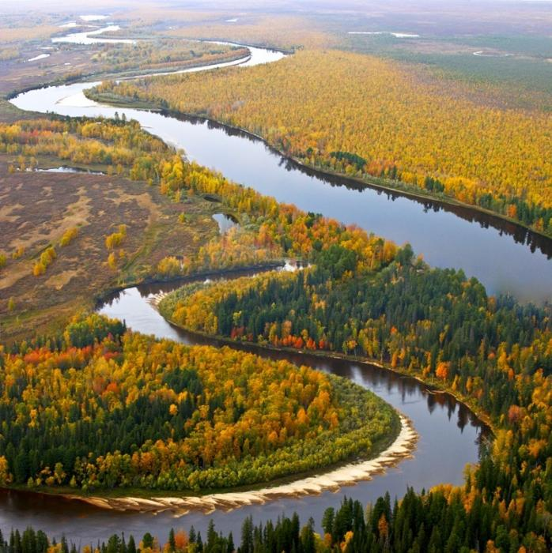
It originates in the Altai and flows into the Kara Sea.

Slide 5
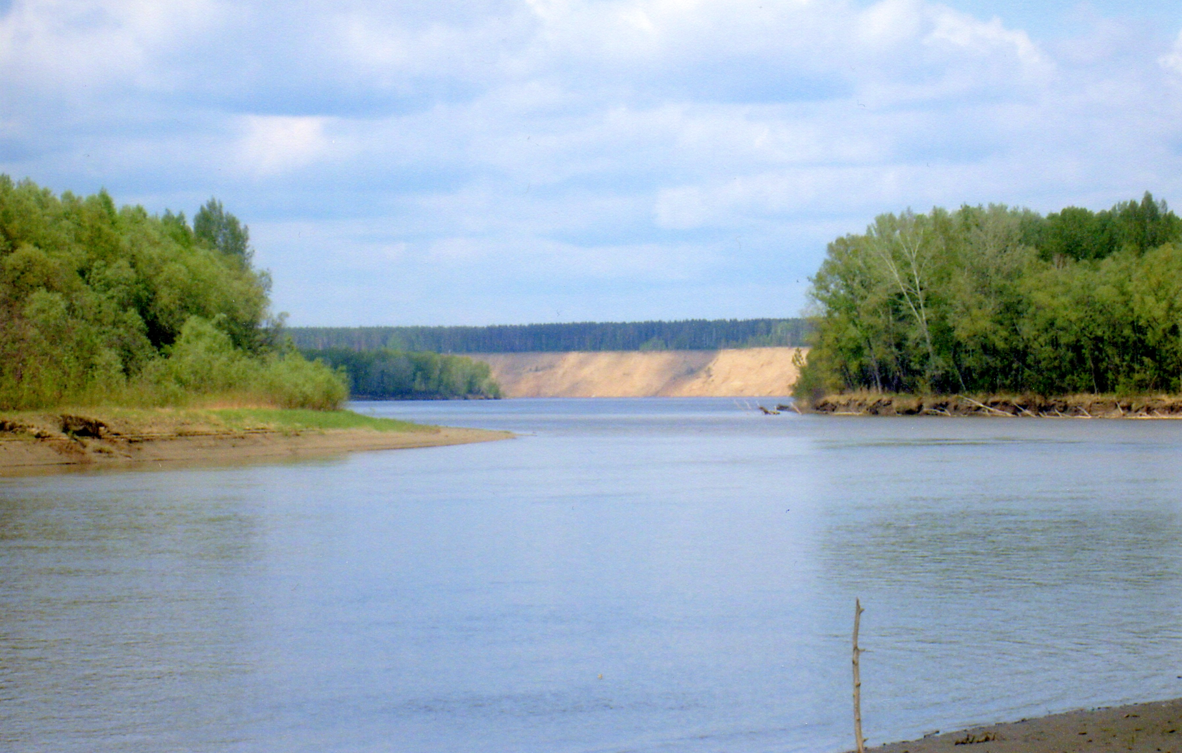
The length of this river is 3650 m

Slide 6
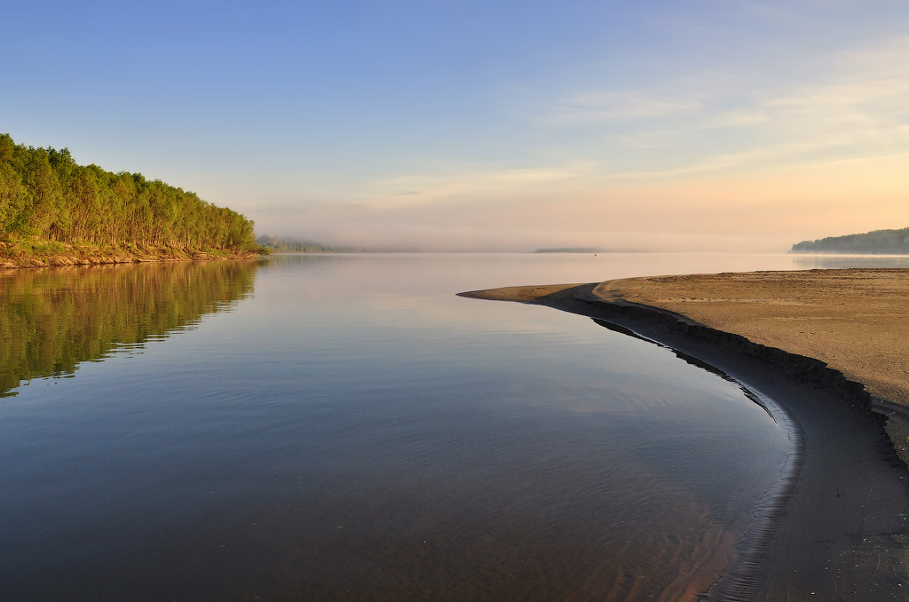
The Ob River ranks first place in Russia in its acreage.

Slide 7
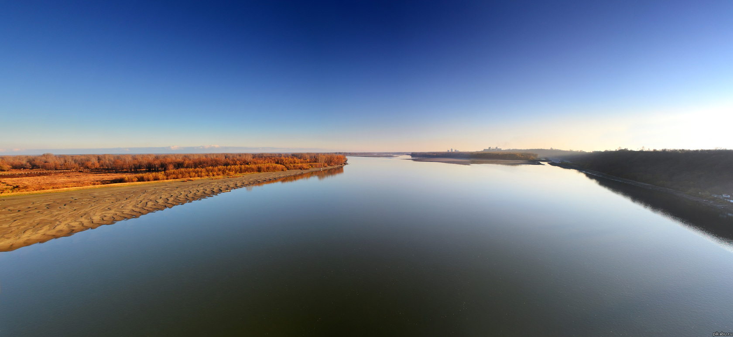
Its acreage is 2 990 000 km ².

Slide 8
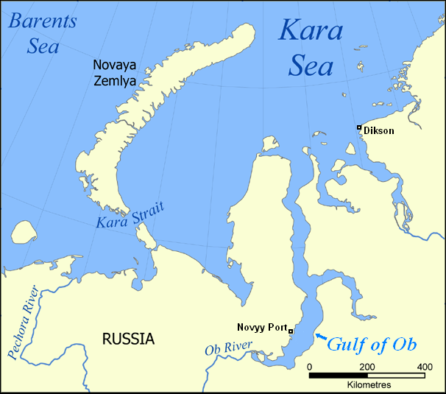
At the estuary this river forms the Gulf of Ob.

Slide 9
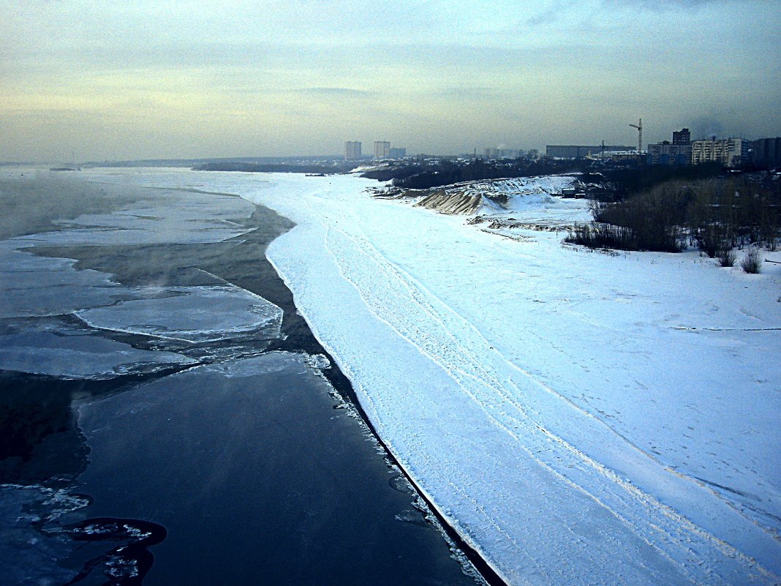
The Ob River feeds on snow.

Slide 10
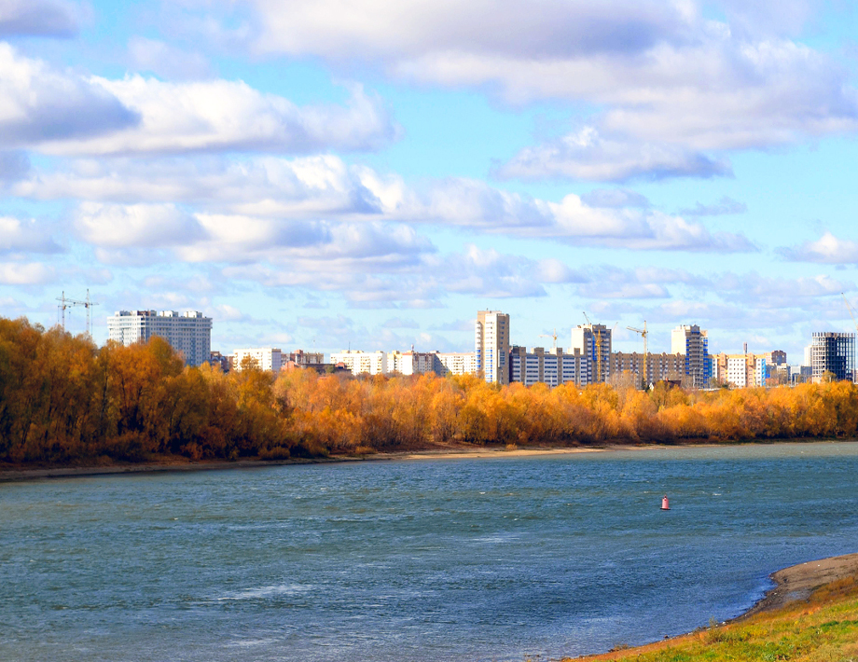
The main tributary of the river is the Irtysh.

Slide 11
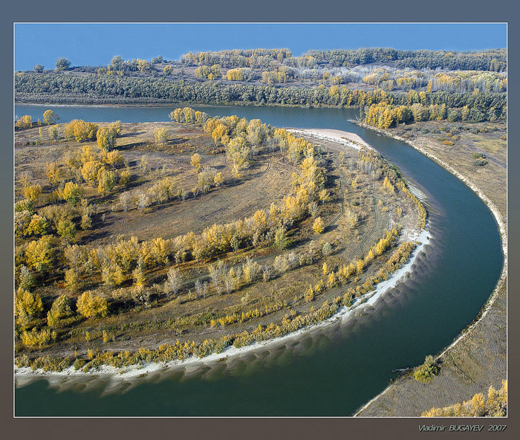
The length of the Irtysh is 4248 km, which exceeds the length of the river itself.

Slide 12
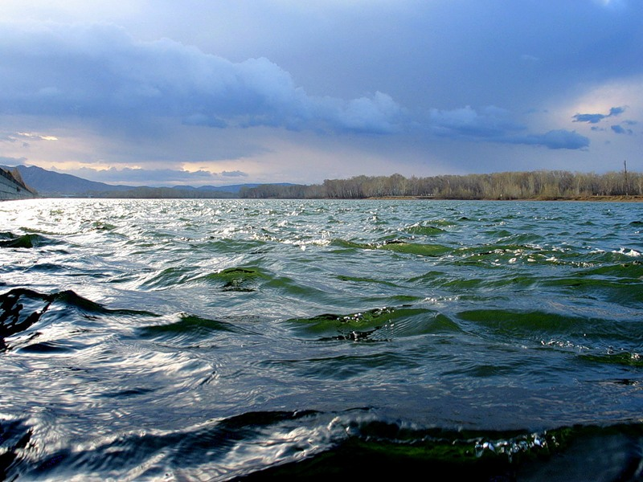
This river is not only beautiful, but also useful for people who live in Russia.

Slide 13
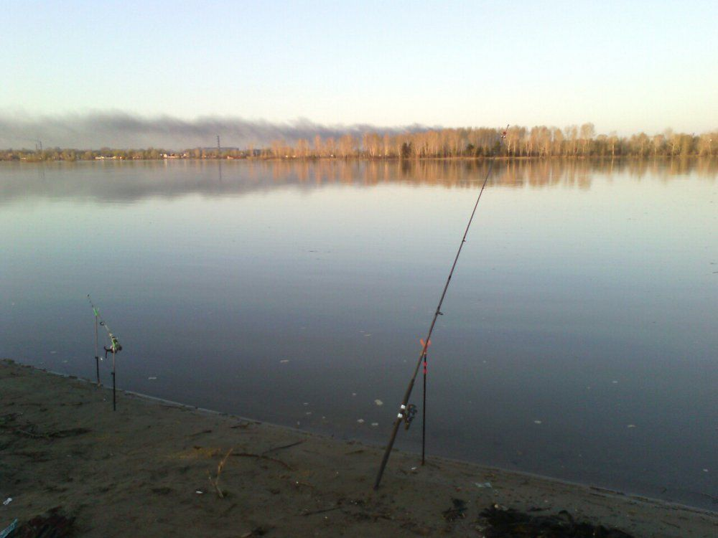
At the moment, about 50 species of fish live in the waters of the Ob, half of them are of industrial value.

Slide 14
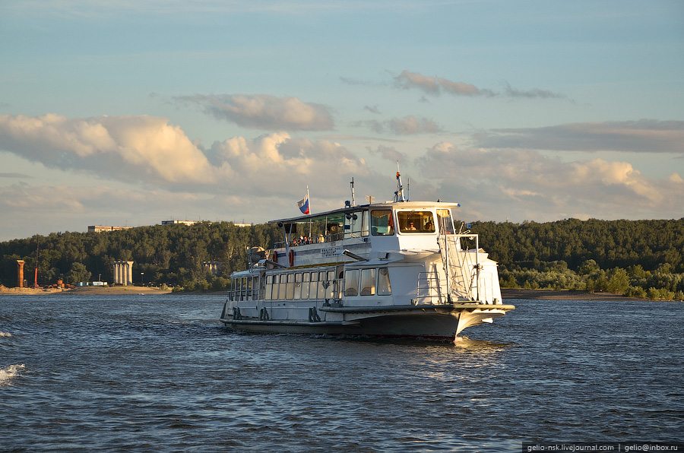
Since 1923, passenger transportation has been carried out on the Ob river.

Slide 15
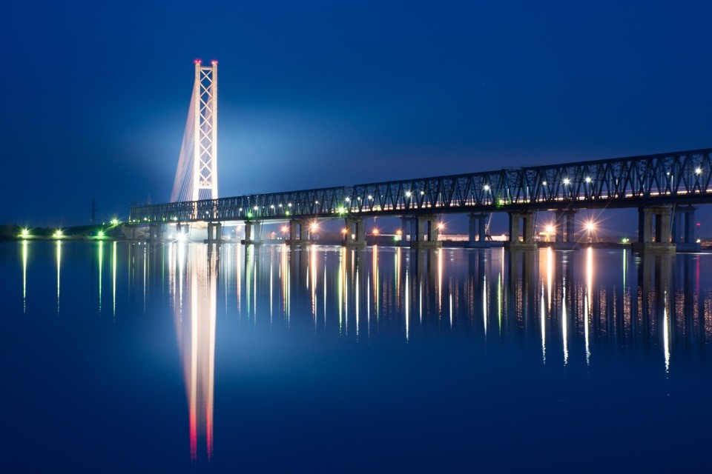
Beautiful bridges were built on the Ob river. For example:
Yugorskiy Bridge

Slide 16
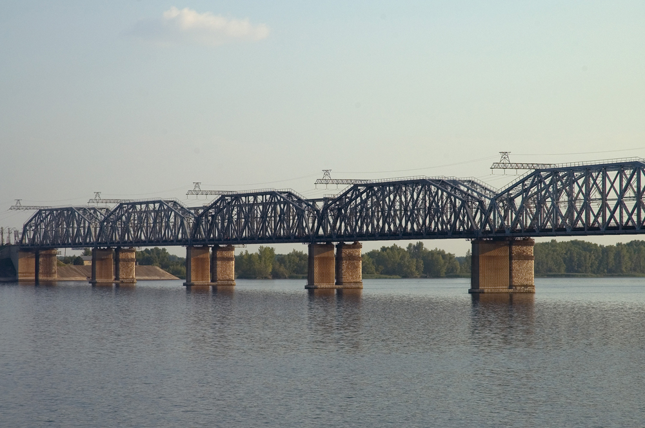
The Transsib bridge

Slide 17
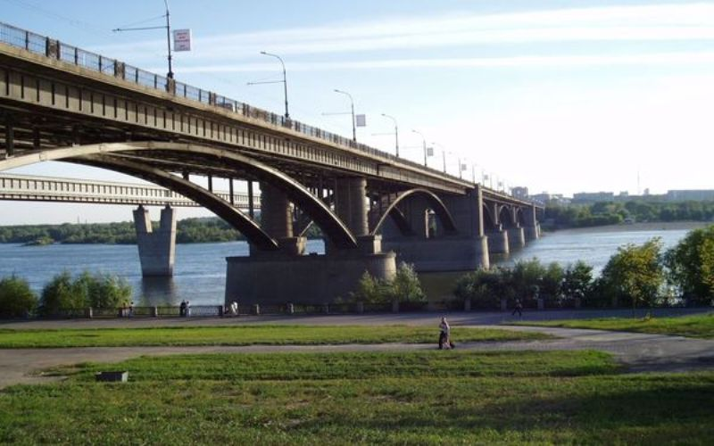
The October Bridge

Slide 18
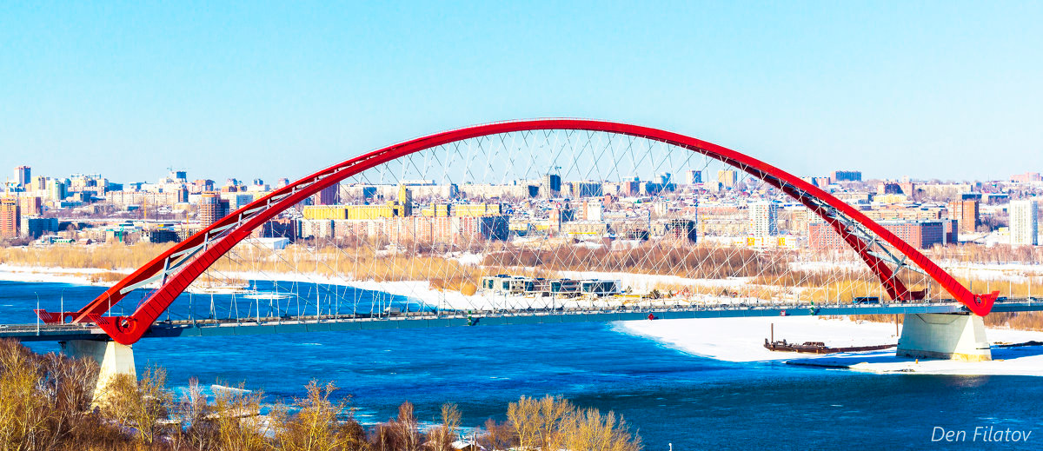
Bugrinsky Bridge

Slide 19
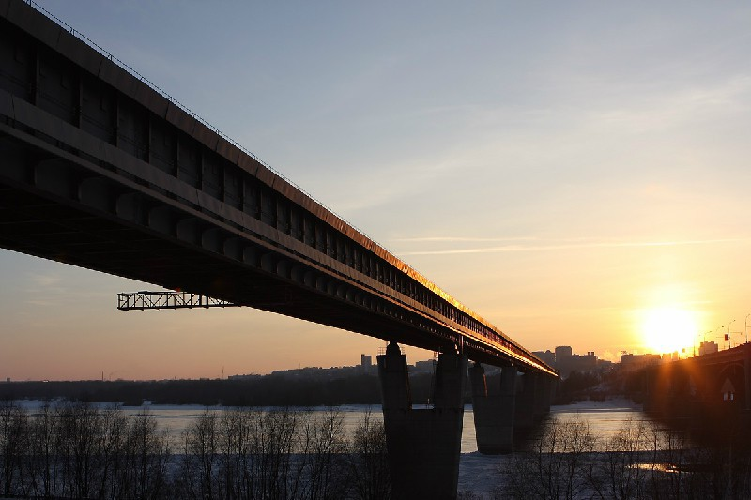
Metro Bridge

Slide 20
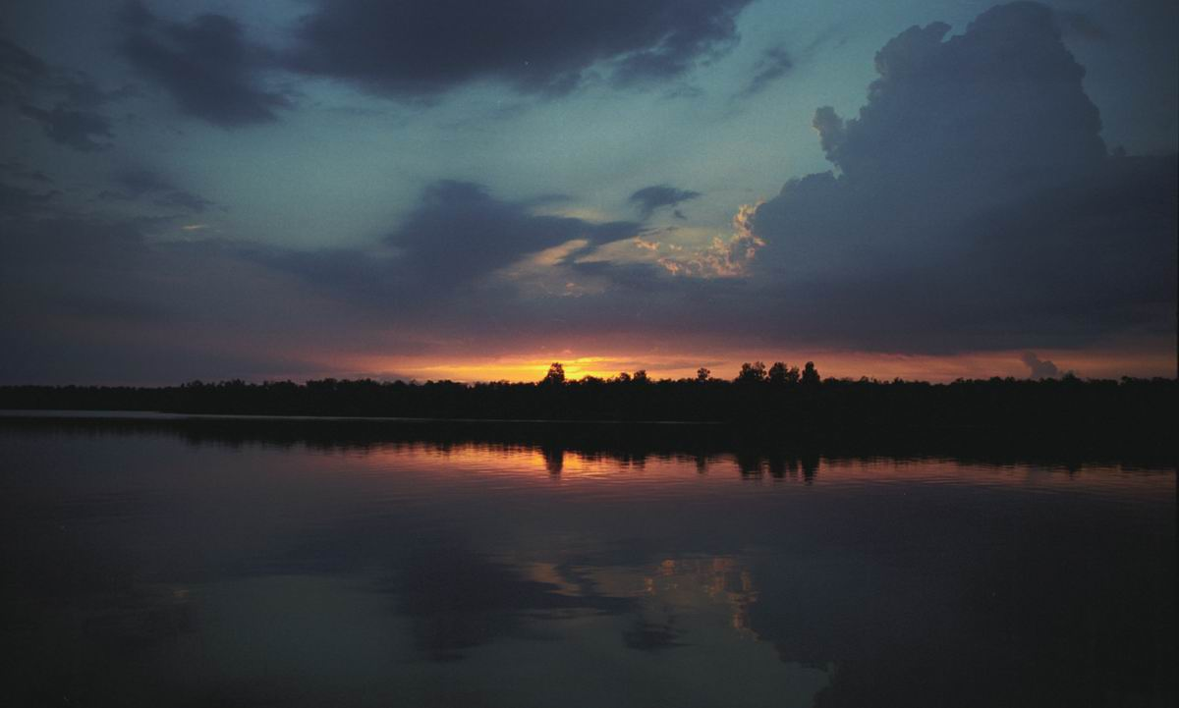
Thus, the river Ob can be called the pride of Russia.

